Slide 1
DADAISM
After-effects of World War I
Absurd art
Rejection of Logic and Reason
History of Modern Art
BFA-III (Visual Arts)
Course Incharge: Ms. Sidra Liaqat
Institute of Design & Visual Arts, LCWU

Slide 2
INNOVATIONS
Irreverence
Ready-mades and Assemblage
Chance
Freedom
Wit and Humor

Slide 3
Marcel Duchamp
(1887-1968)
French-American

Slide 4
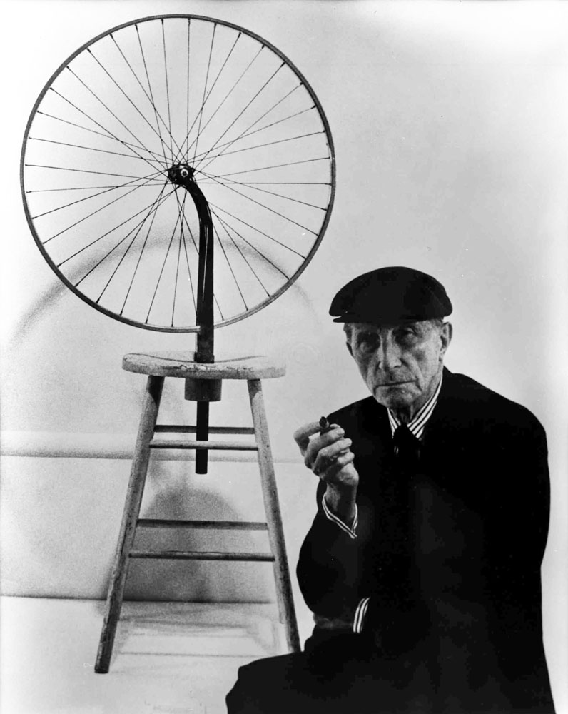
MARCEL DUCHAMP “Bicycle Wheel”
Ready-made
(1913)

Slide 5
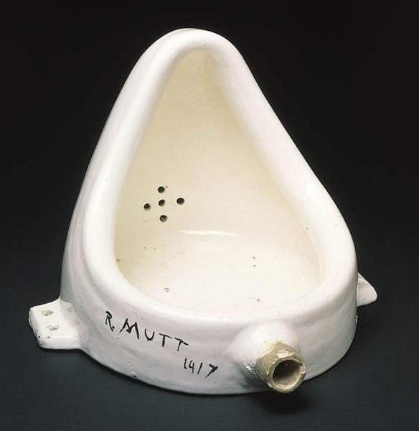
MARCEL DUCHAMP “Fountain”
Ready-made
(1917)

Slide 6
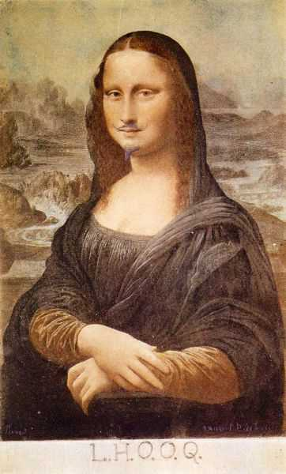
MARCEL DUCHAMP
“L.H.O.O.Q.”
Pencil on a print of Leonardo da Vinci’s Mona Lisa (Ready-made)
(1919)

Slide 7
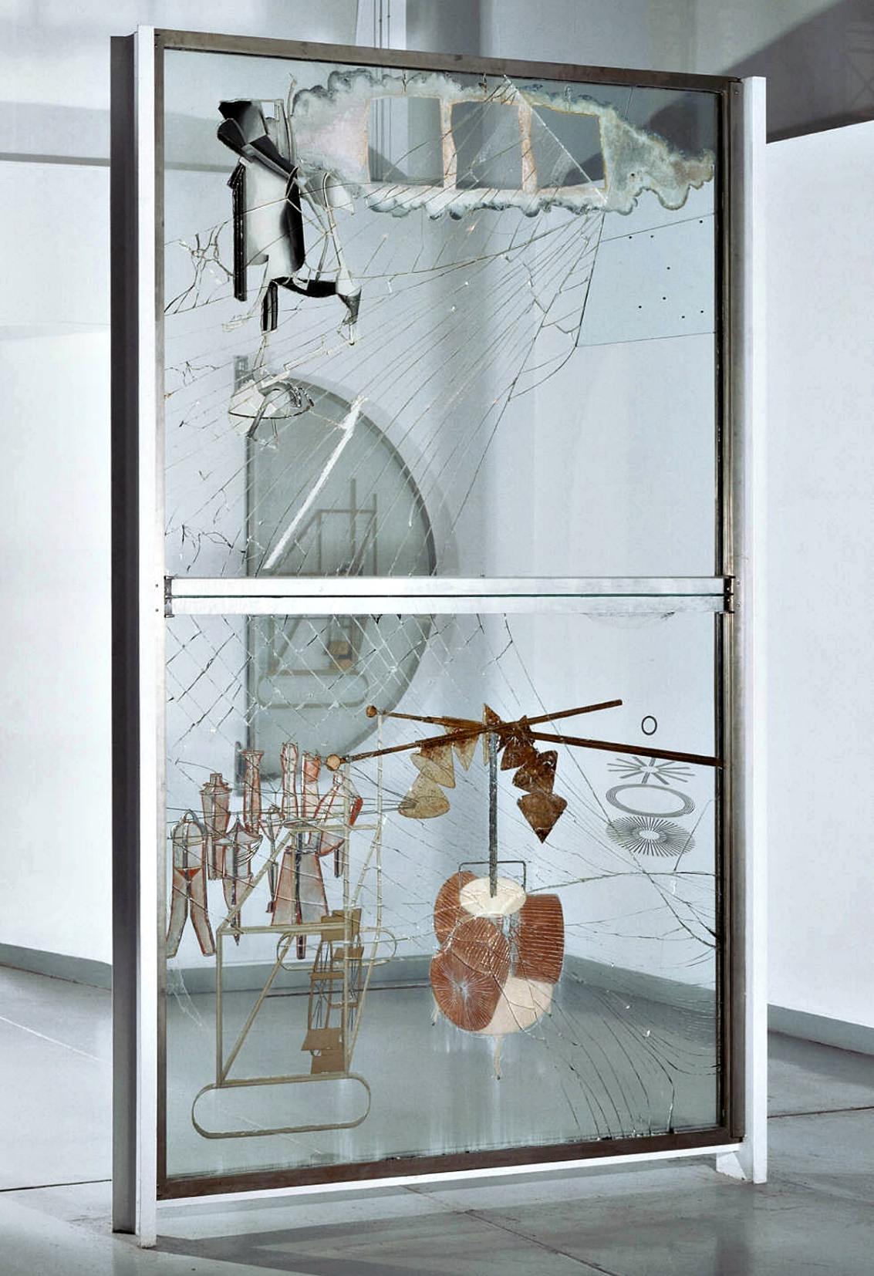
MARCEL DUCHAMP
“The Large Glass”
Oil paint, lead, wire, foil, dust and varnish on glass
(1915–1923)

Slide 8
Jean (Hans) Arp
(1886-1966)
German-French

Slide 9
JEAN ARP
“Collage Arranged According to the Laws of Chance”
(1917)

Slide 10
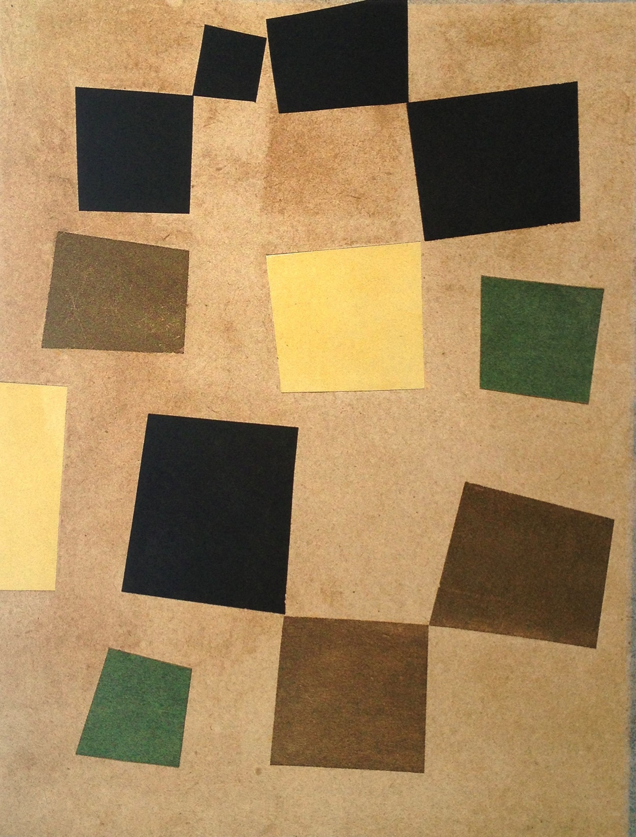
JEAN (HANS) ARP
“Untitled”
(Squares Arranged According to the Laws of Chance)
(1917)

Slide 11
Hannah Höch
(1889-1978)
German

Slide 12
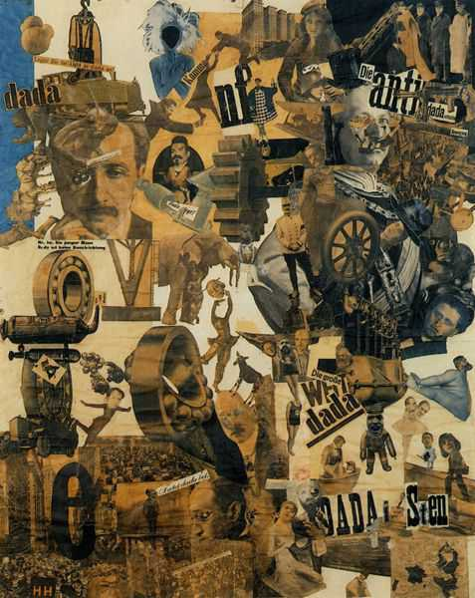
HANNAH HÖCH
“Incision with the Dada Kitchen Knife through Germany's Last Weimar Beer Belly Cultural Epoch”
Collage
(1920)

Slide 13
Kurt Schwitters
(1887-1948)
German

Slide 14
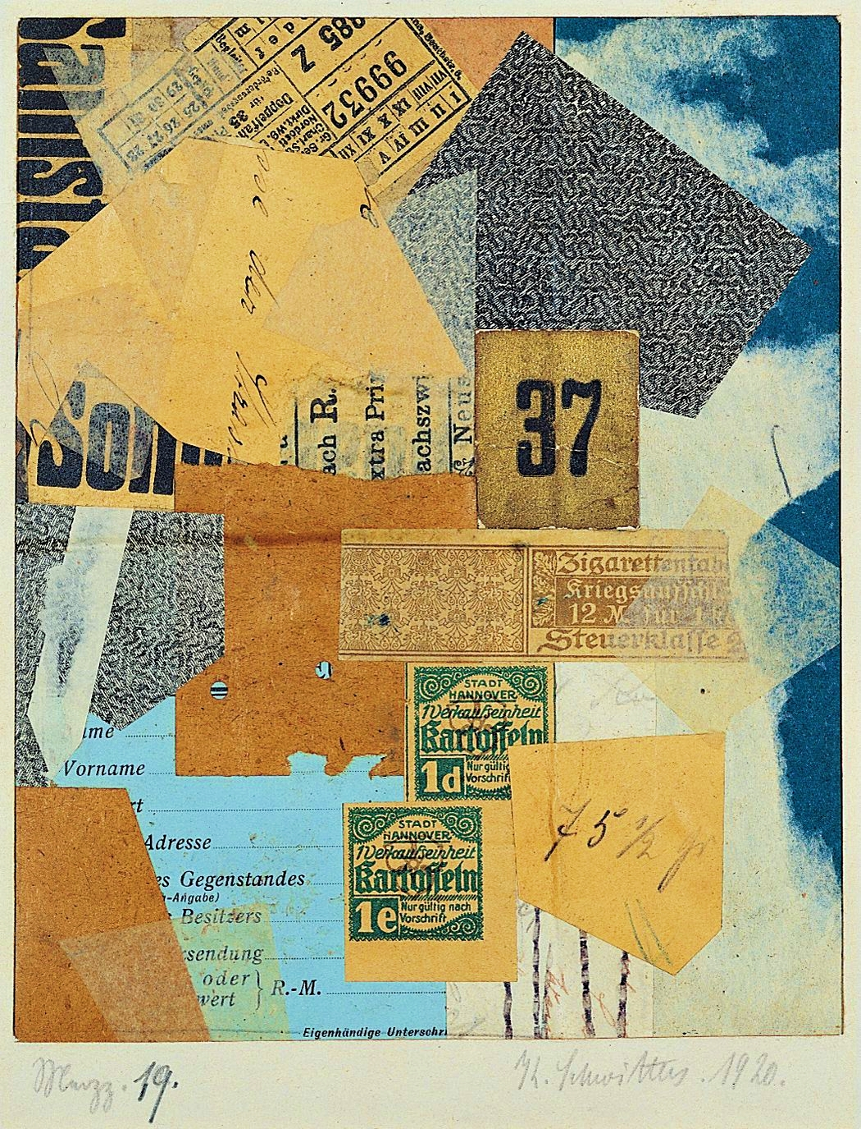
KURT SCHWITTERS
“Merz 19”
Paper Collage
(1920)

Slide 15
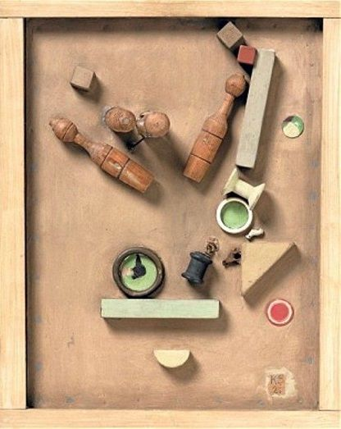
KURT SCHWITTERS
“Merz 46”
Assemblage of wood, oil, metal, board on board, with artist's frame
(1921)

